Slide 1
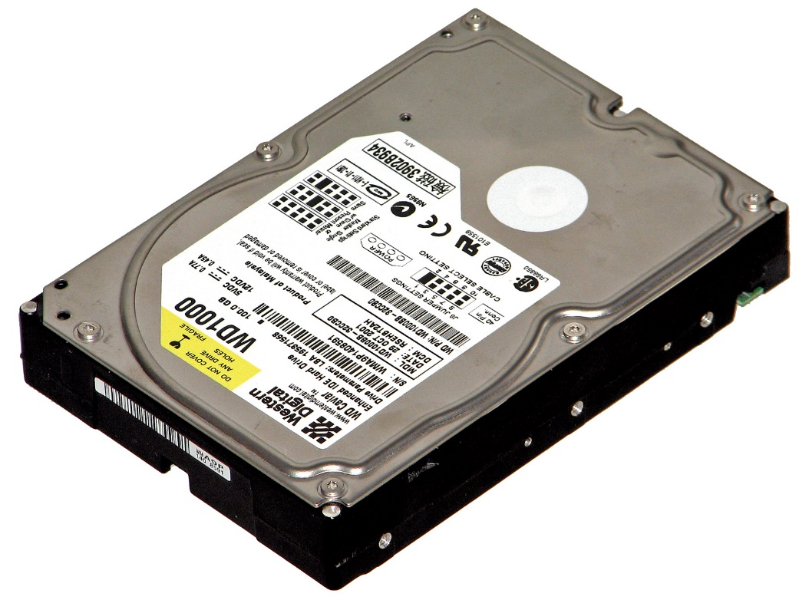
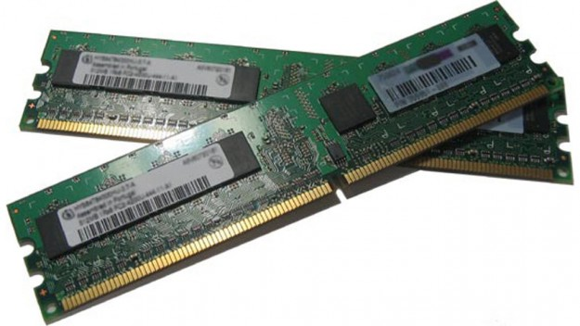
Memory Organization
Computer Architecture

Slide 2
Main Memory (e.g. RAM)
Main Memory
Main
Data
Storage
(0.5–4 Gb)
Program
Storage
(0.5–4 Gb)
High Speed
Memory Bus
Central
Processor
Motherboard

Slide 3
External Memory (e.g. Hard Disk Drive)
Main Memory
Main
Data
Storage
Program
Storage
IDE or SATA
Cable Interface (Slower Speed)
Data
&
Program
Storage (0.5-4 Tb)
High Speed
Memory Bus
Central
Processor
External Memory
Motherboard

Slide 4
Cache Memory
Main Memory
Main
Data
Storage
Program
Storage
Data
&
Program
Storage (0.5-4 Tb)
Cache
Cache Features:
Extreme High Speed
Small Size (512 Mb)
Buffer
Pre-fetch
Cache
Central
Processor
External Memory
Motherboard

